Slide 1
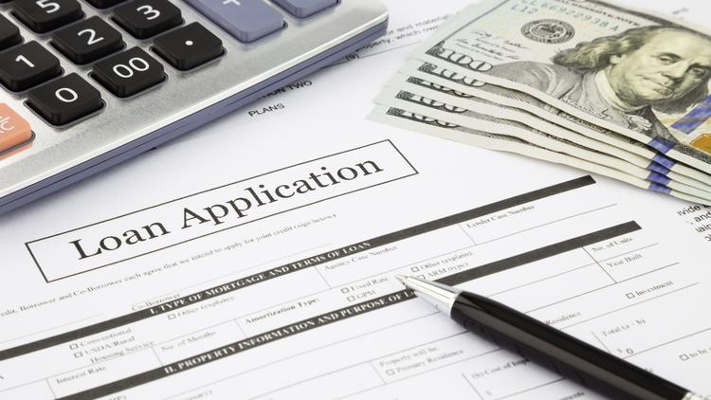
Bank Loan Decision Modelling
By : -
Narender Reddy Konuganti
Gopi Sandeep Guntuku
Sai Charan Pappala
Sukumar Reddy Kottala

Slide 2

Business Problem
Predict whether a customer will respond to a Personal Loan Campaign.
Solution
The classification goal is to predict the likelihood of a liability customer buying personal loans.
Notes:
Here is the project flow we used. We will review the data source and prepare data, then modeling and interpreting the resutls

Slide 3
Project Flow
1
3
Data Cleaning
Data Validation
Visualization
Data partition
Evaluation
Recommendations
Future Work
Data Source
Modeling
Data Preparation
Interpreting the Results
Data Sources
Dataset Description
Technique/solution
Inputs/output
2
4
Notes:
Here is the project flow we used. We will review the data source and prepare data, then modeling and interpreting the resutls

Slide 4
Project Flow
1
3
Data Cleaning
Data Validation
Visualization
Data partition
Evaluation
Recommendations
Future Work
Data Source
Modeling
Data Preparation
Interpreting the Results
Data Sources
Dataset Description
Technique/solution
Inputs/output
2
4
Notes:
Here is the project flow we used. We will review the data source and prepare data, then modeling and interpreting the resutls

Slide 5
Data source
Dataset:
https://www.kaggle.com/teertha/personal-loan-modeling
The Dataset contains data of 5000 customers.
The data includes:
Customer demographic information (age, income, etc.),
The customer's relationship with the bank (mortgage, securities account, etc.)
Customer response to the last personal loan campaign (Personal Loan).
Among these 5000 customers, only 480 (= 9.6%) accepted the personal loan that was offered to them in the earlier campaign.

Slide 6
Dataset description
Field Names
ID
Age
Experience
Income
ZIP Code
Family
CCAvg
Education
Mortgage
Personal Loan
Securities Account
CD Account
Online
Credit Card
Bank Personal Loan dataset
14 Data Fields
Total of 5000 customers

Slide 7
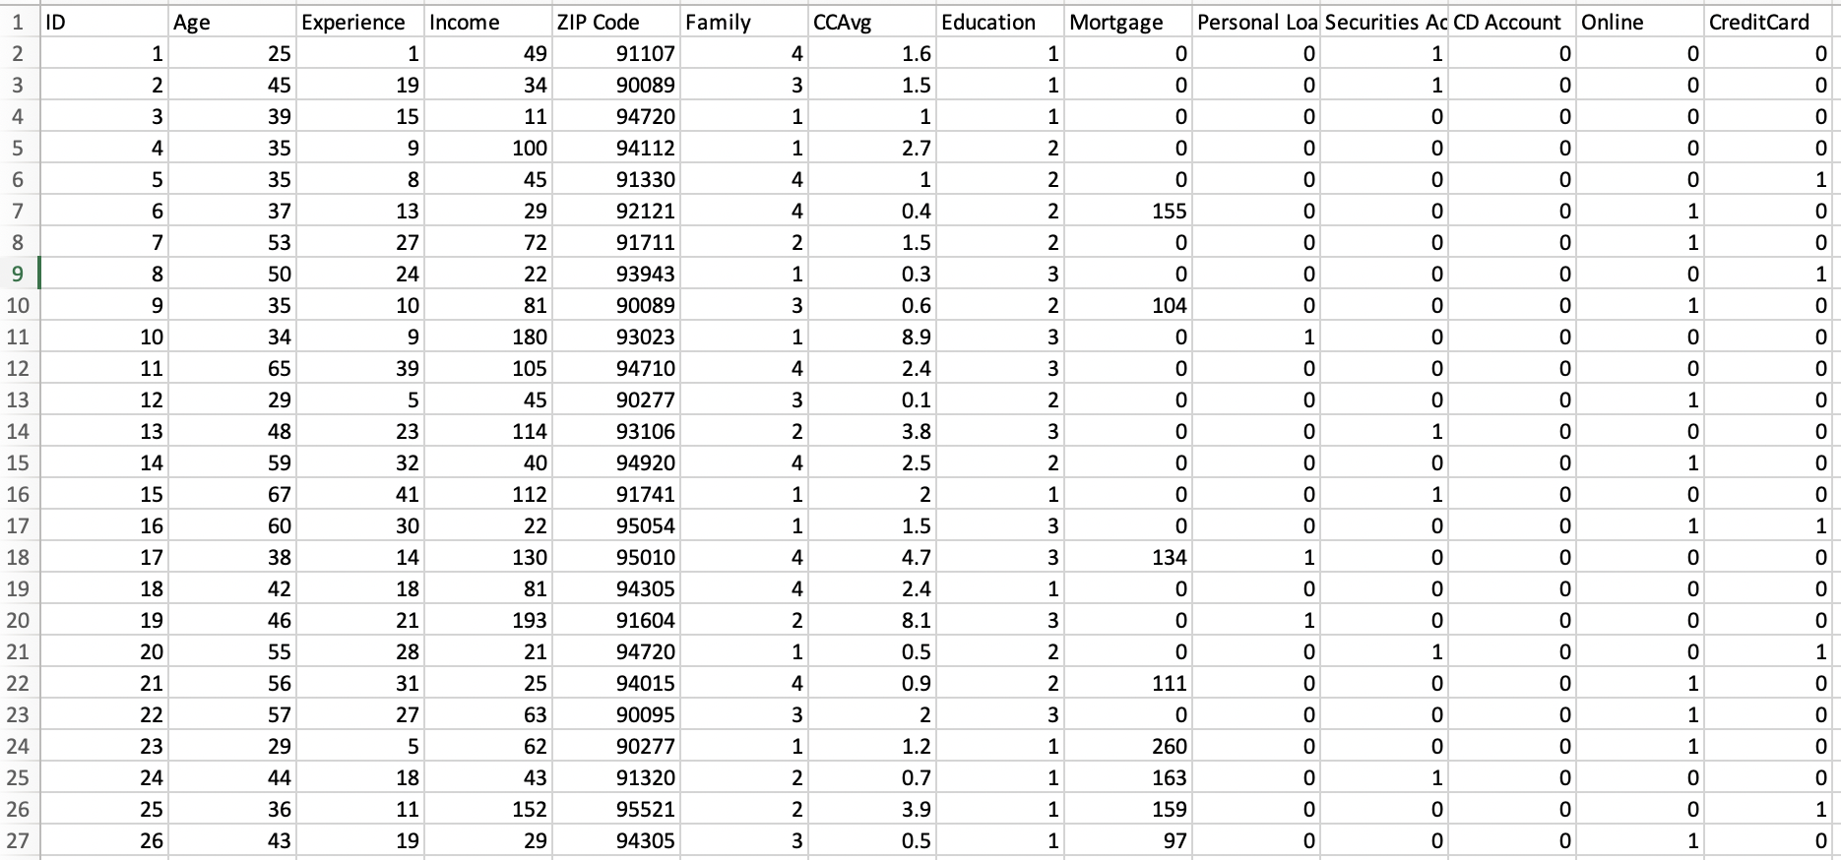
A Snippet of the Dataset
Bank Personal Loan dataset

Slide 8
Project Flow
1
3
Data Cleaning
Data Validation
Visualization
Data partition
Evaluation
Recommendations
Future Work
Data Source
Modeling
Data Preparation
Interpreting the Results
Data Sources
Dataset Description
Technique/solution
Inputs/output
2
4
Notes:
Here is the project flow we used. We will review the data source and prepare data, then modeling and interpreting the resutls

Slide 9
Analyzing and Exploring Data
Data understanding such like its information, description, uniqueness
Dropping the unnecessary features
Replacing Null, NAN values with Mean or Median, checking for outliers
Adding new column(s)
Notes:
This step is reviewing the overall data. Initial assessment of the data to identify which columns are Quantitative, Categorical or Qualitative.
There is no missing values in the data.

Slide 10
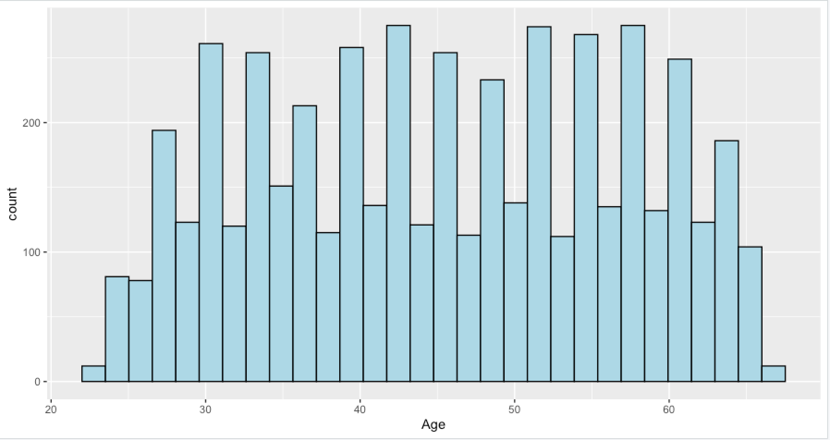
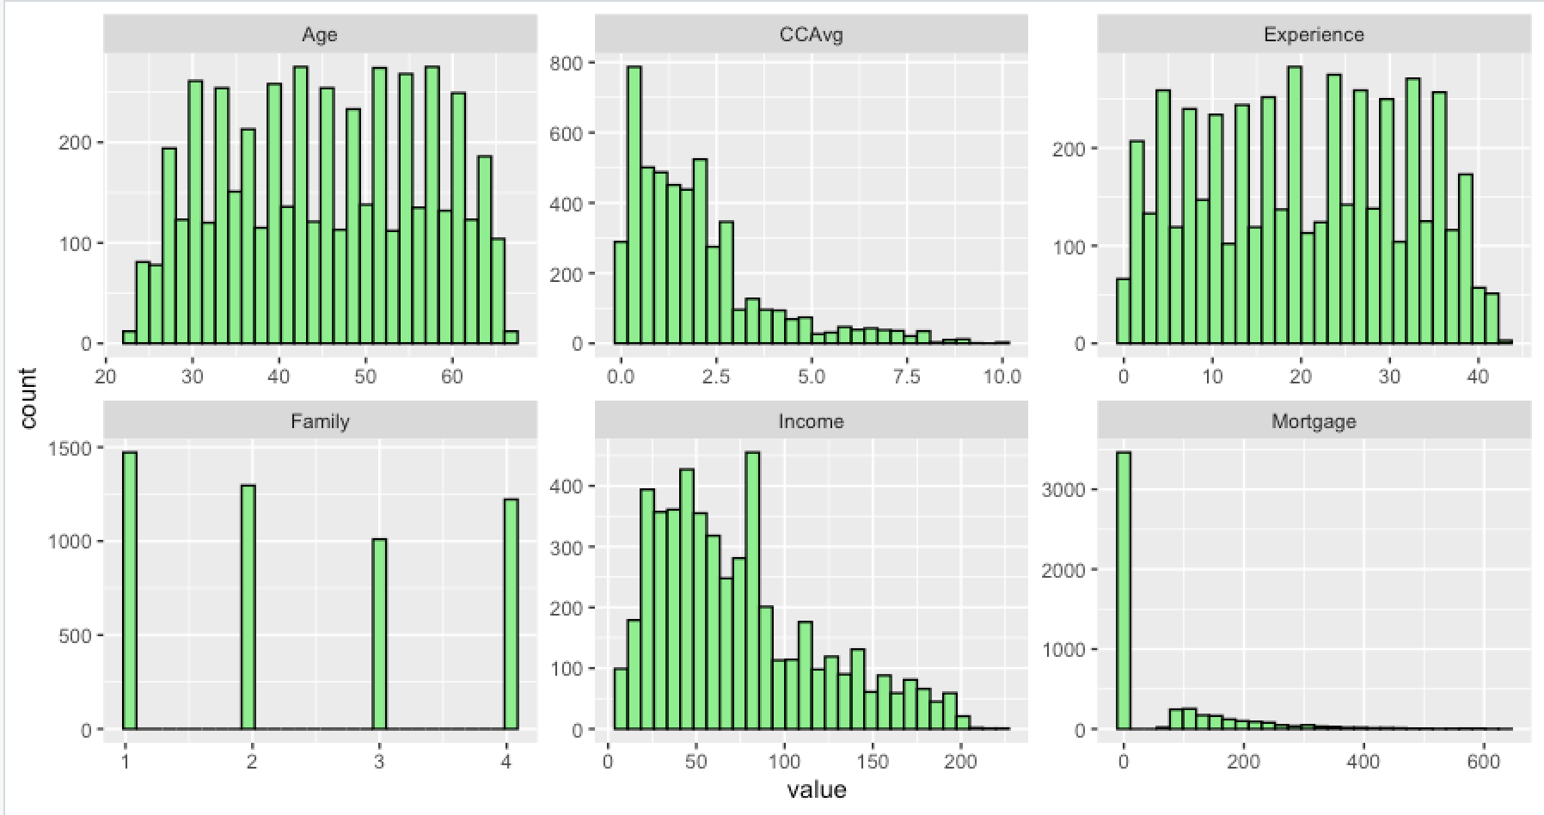
Visualizing The Data
Age vs Count
Value vs Count
Histogram
Notes:
This bar chart - countplot
import seaborn as sns library
X = Count
Y: Hear disease & no disease
No Disease has the highest count :203 percentage in pie chart 67.9%

Slide 11
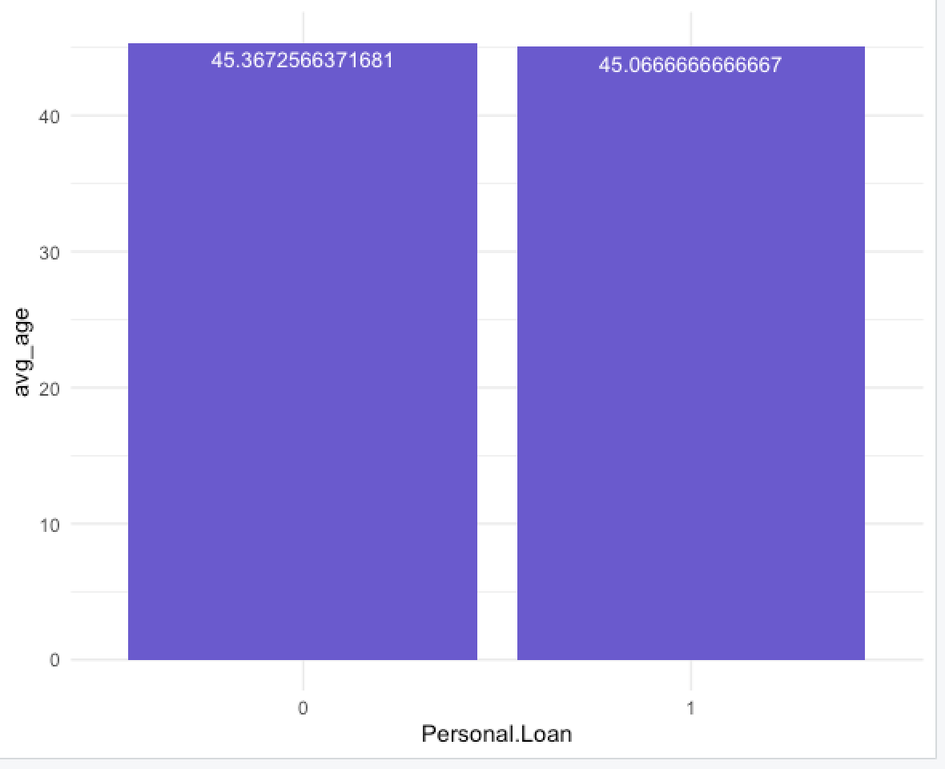
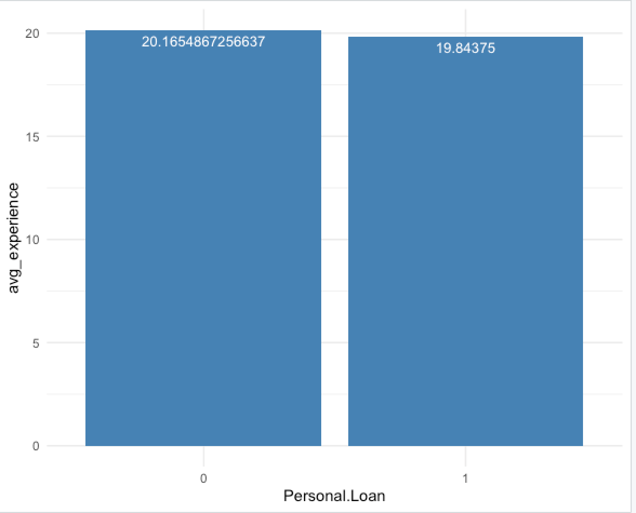
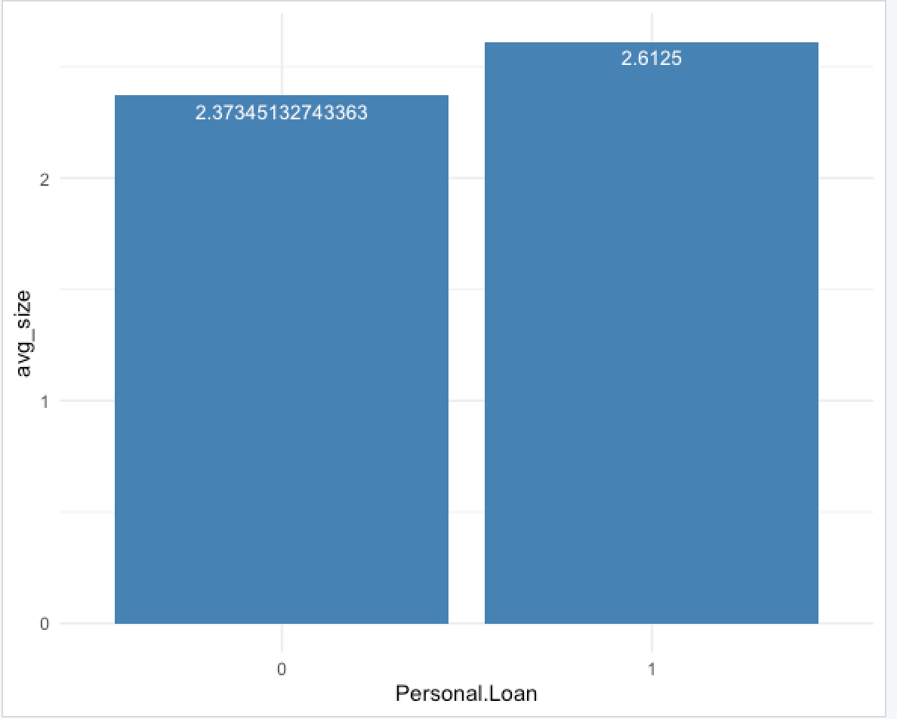
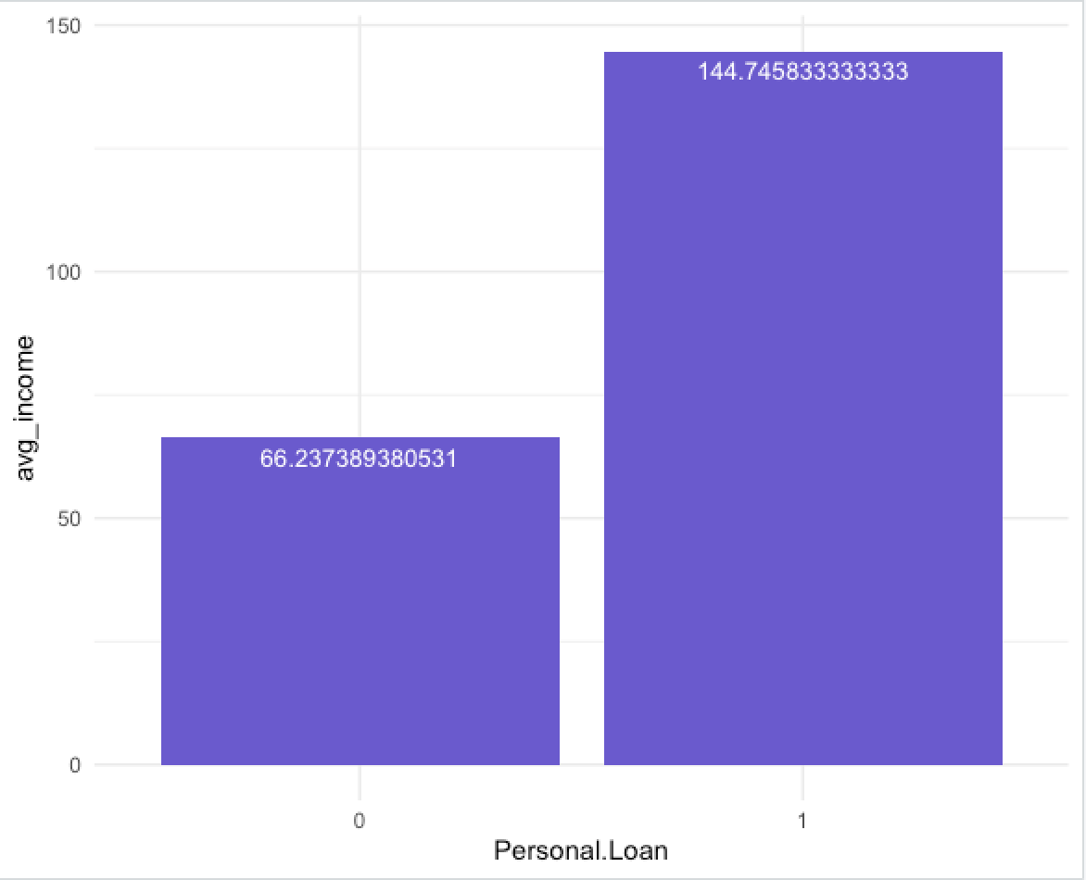
Histogram
Visualizing The Data
Personal Loan vs Other Predictors

Slide 12
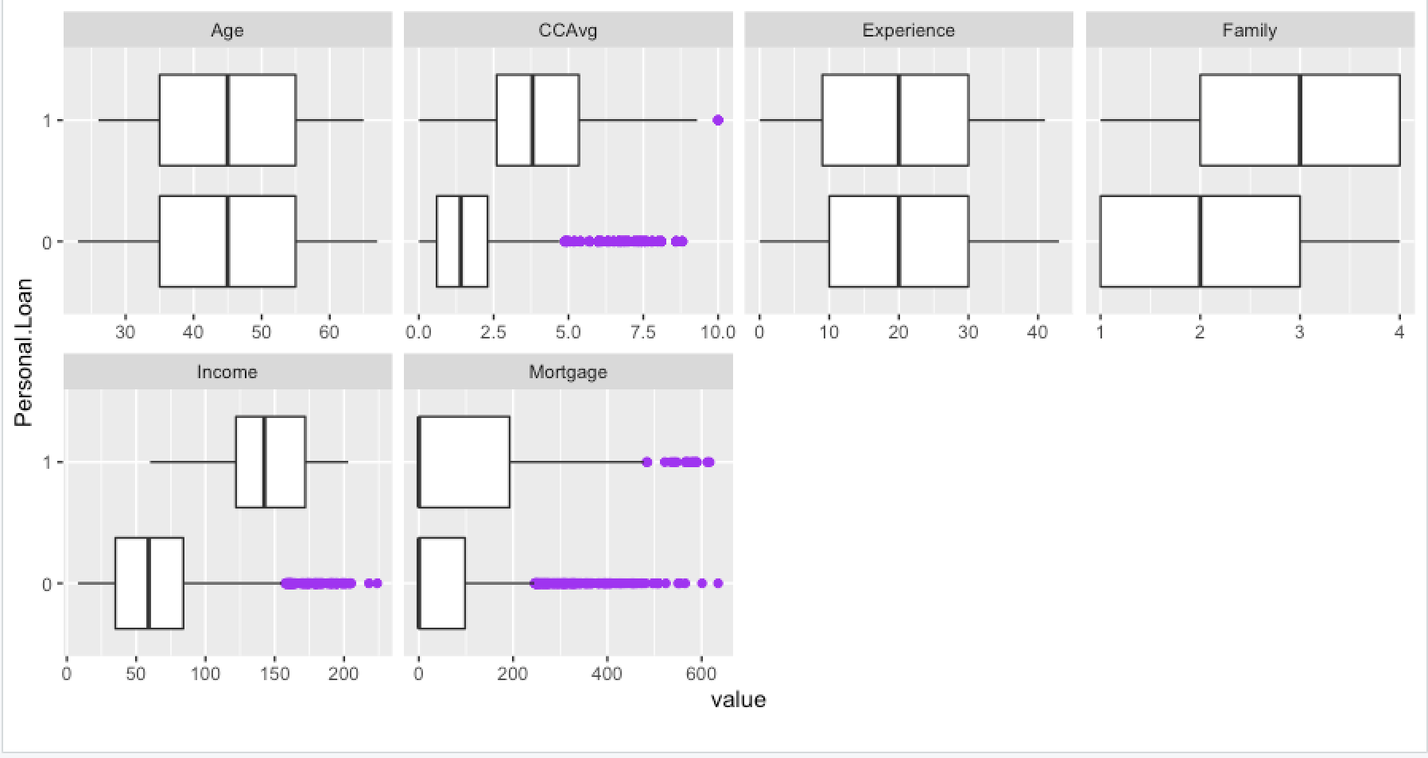
Visualizing The Data
Box Plot
Input vs Output

Slide 13
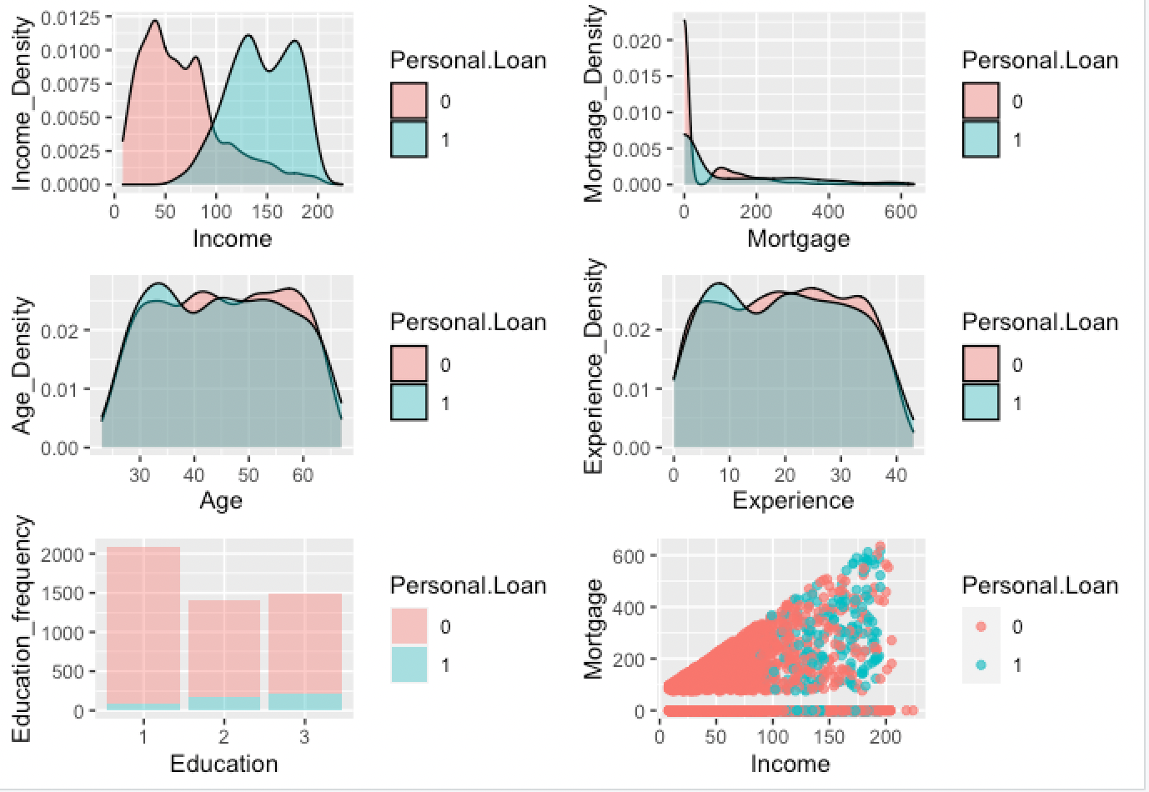
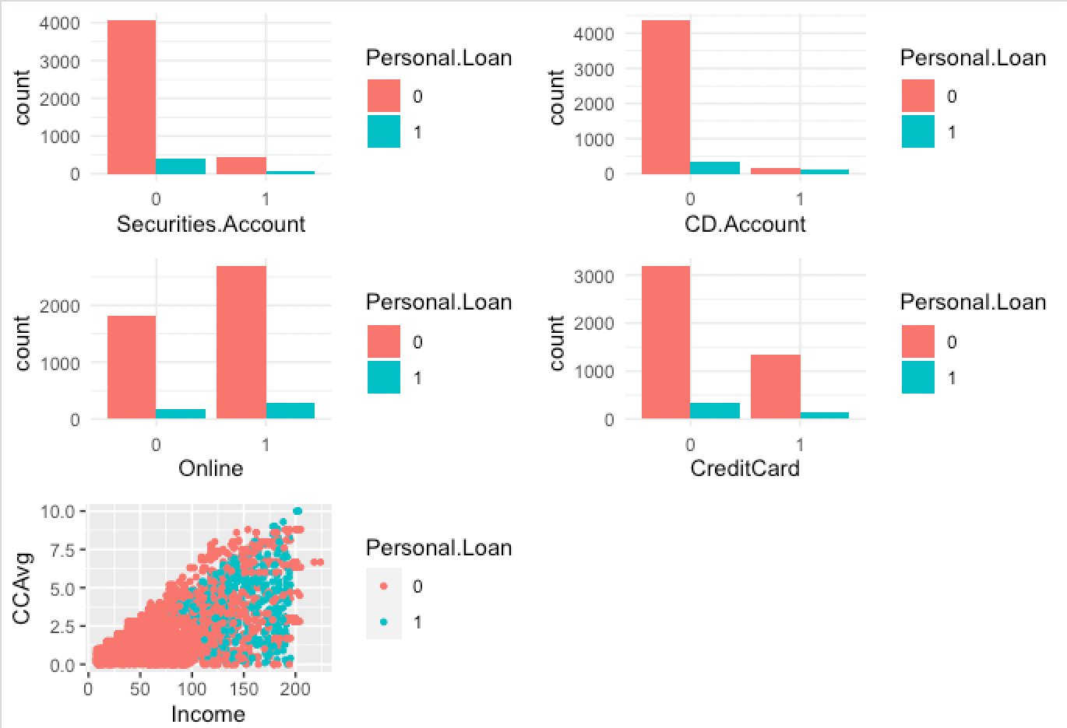
EDA
EDA
Data Exploration and Preprocessing
Target variable
Predictors
Models

Slide 14
Project Flow
1
3
Data Cleaning
Data Validation
Visualization
Data partition
Evaluation
Recommendations
Future Work
Data Source
Modeling
Data Preparation
Interpreting the Results
Data Sources
Dataset Description
Technique/solution
Inputs/output
2
4
Notes:
Here is the project flow we used. We will review the data source and prepare data, then modeling and interpreting the resutls

Slide 15
Model Algorithms
Target Variable: Personal Loan
Predictors: ID, Age, Experience, Income, ZIP Code, Family, CC Avg, Education, Mortgage, Securities account, CD Account, Online, Credit card.
Logistic Regression
Target variable
Predictors
Models
Random Forest
KNeighborsClassifier
Neural Networks
Ensemble Voting & Weighted Average
Notes:
We didn't use the full data for creating the model. Some data is randomly selected and kept aside for checking how good the model is. This is known as Testing Data and the remaining data is called Training data on which the model is built.
Typically, 80% of data is used as Training data and
the rest 20% is used as Testing data.
# Separate Target Variable and Predictor Variables
Y: TargetVariable=DEATH_EVENT
X: Predictors=Anaemia, Diabetes, High_blood_pressure, Sex, Smoking
Age, Creatinine_phosphokinase, Ejection_fraction, Platelets, Serum_creatine, Serum_sodium, Time

Slide 16
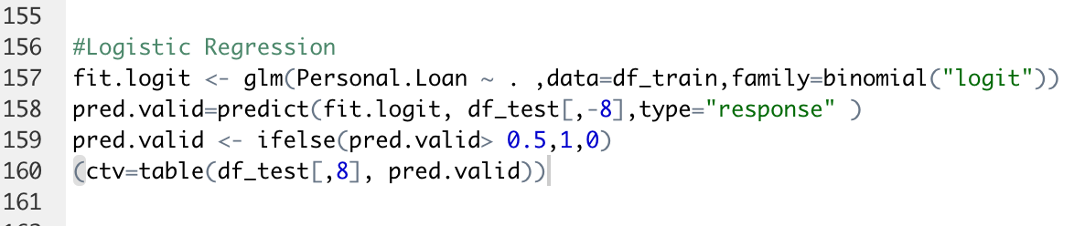
Since we are dealing with a classification problem and expect some linear relationships
between variables, we will use a logistic regression model to classify our data
Logistic
Regression
Target variable
Predictors
Models

Slide 17
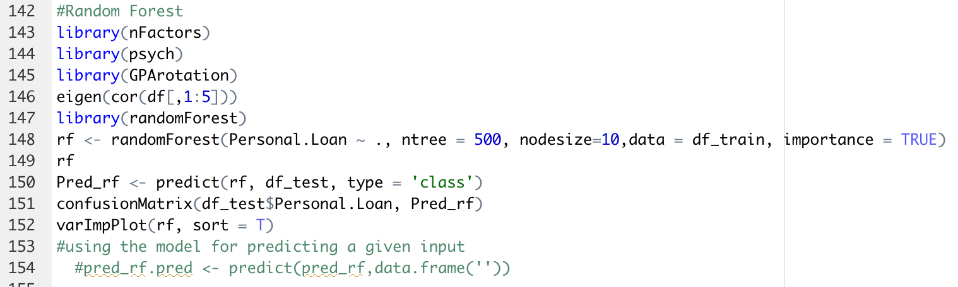
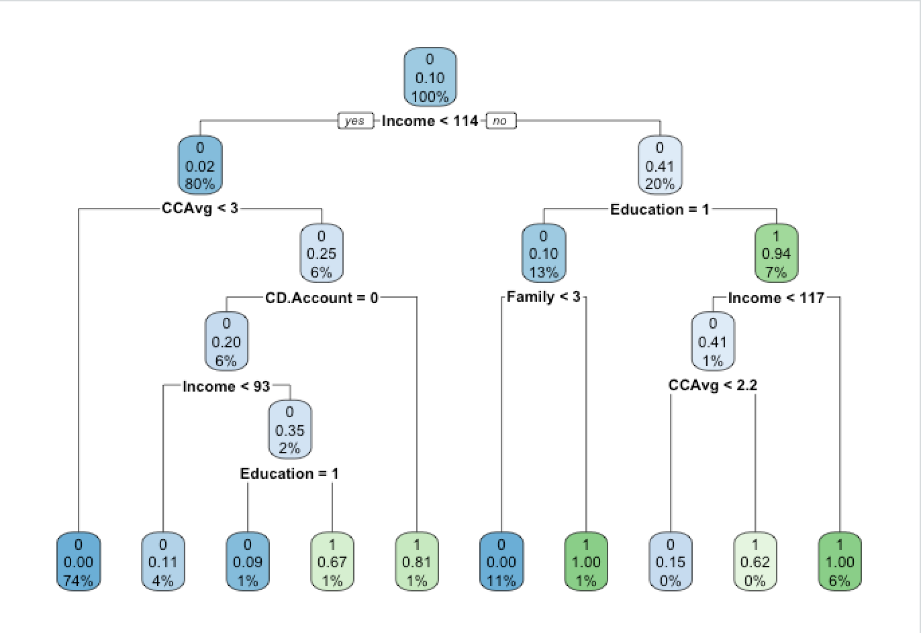
Type of random forest: classification
Number of trees: 500
No. of variables tried at each split: 3
Random
Forest
Target variable
Predictors
Models

Slide 18
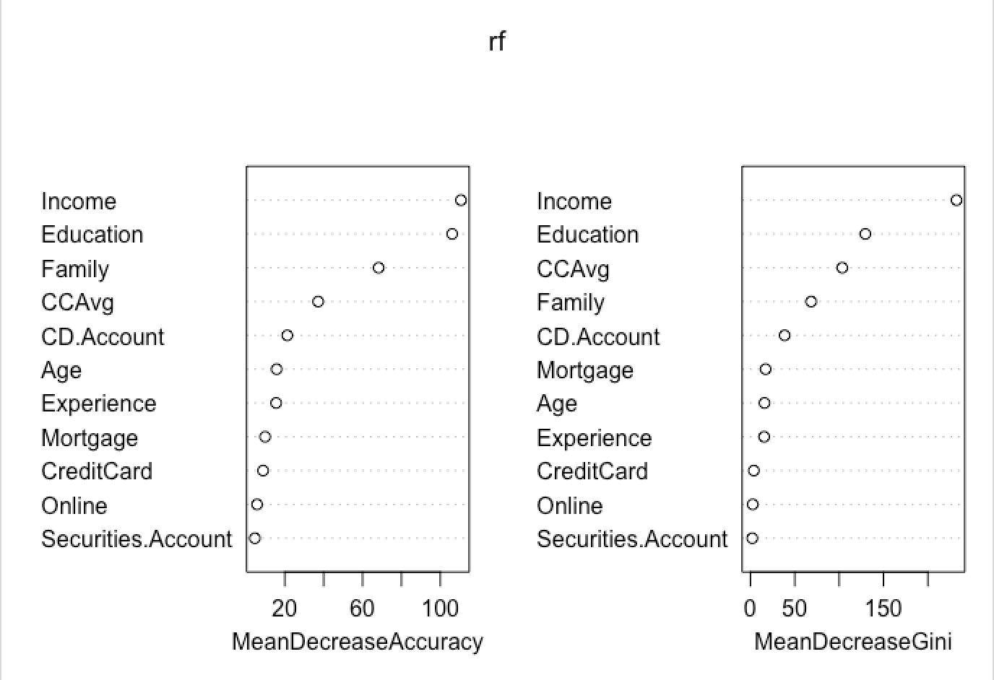
Variable Importance Plot (RF)
Target variable
Predictors
Models

Slide 19
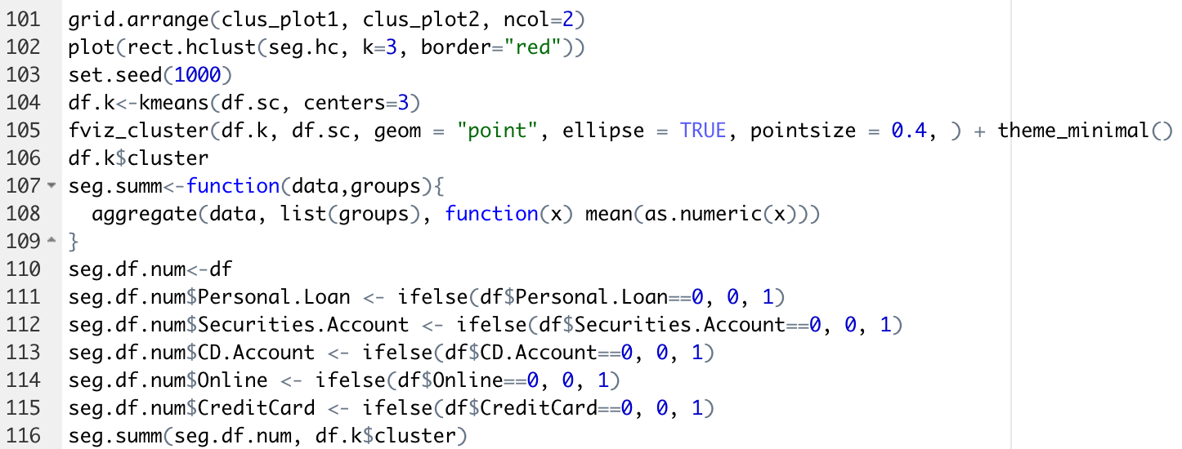
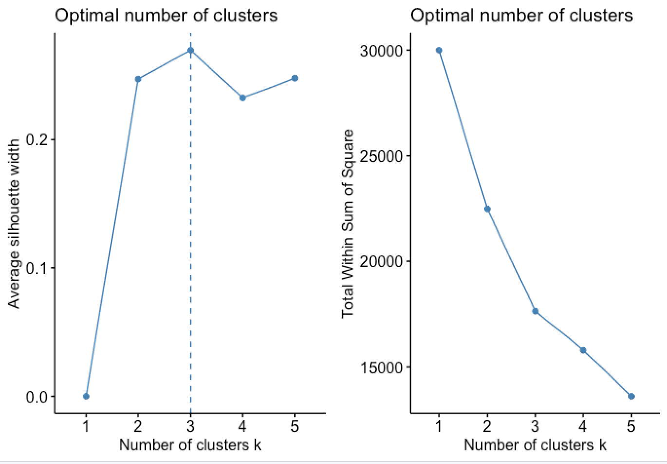
K = 3
Sampling 80% of data for training the algorithms using random sampling
K means clustering
Target variable
Predictors
Models

Slide 20
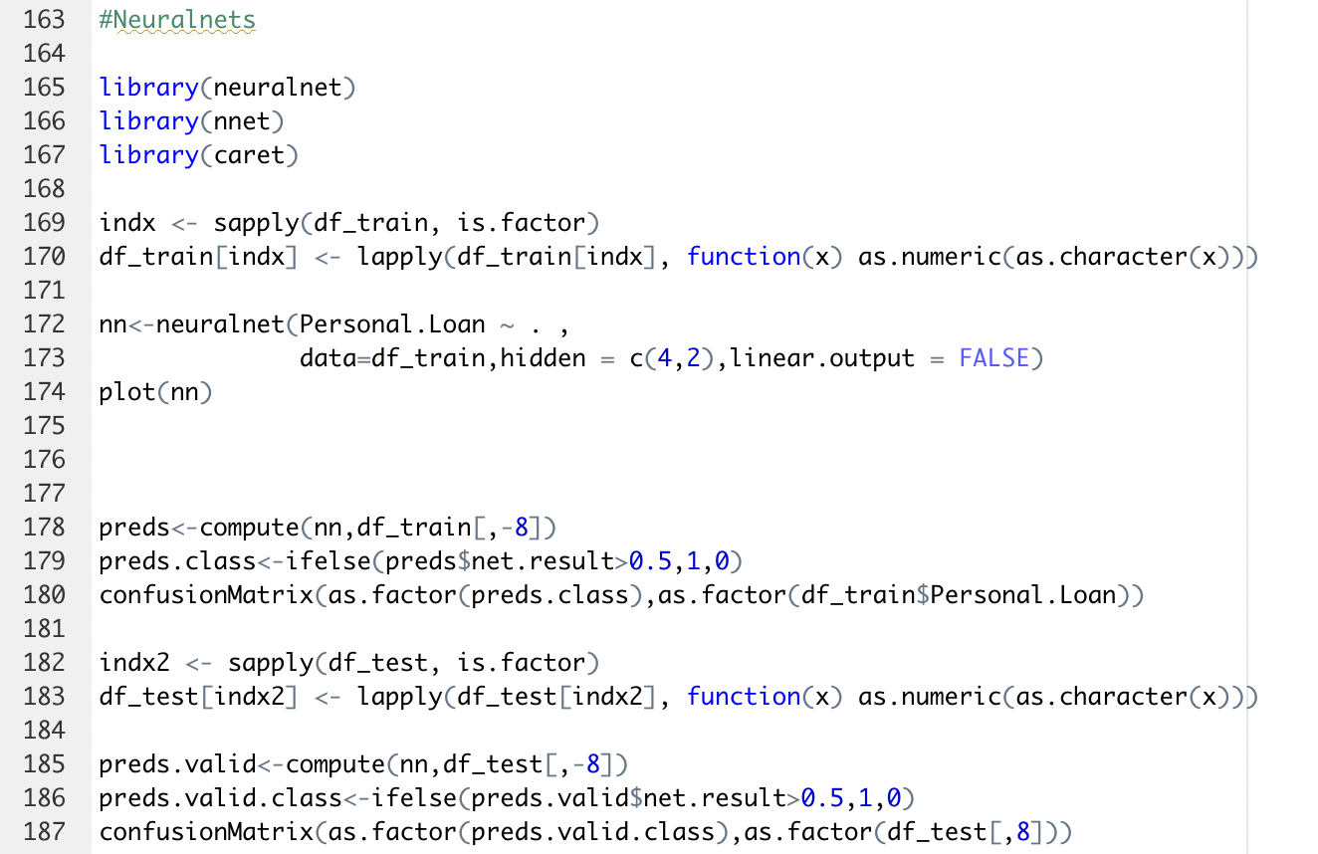
We used neural network to capture complex nonlinear relationships.
This helped identify complex relationships that were missed by some of our other models.
Neural
Networks
Target variable
Predictors
Models

Slide 21
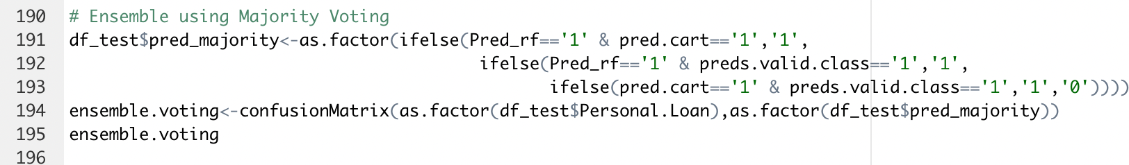
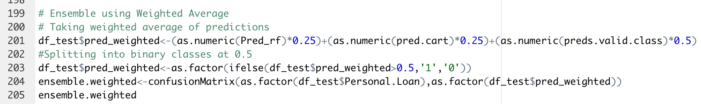
Ensemble by Majority Voting
Ensemble
Target variable
Predictors
Models
Ensemble by Weighted Average

Slide 22
Project Flow
1
3
Data Cleaning
Data Validation
Visualization
Data partition
Evaluation Result
Recommendations
Future Work
Data Source
Modeling
Data Preparation
Interpreting the Results
Data Sources
Dataset Description
Technique/solution
Inputs/output
2
4
Notes:
Last, we will do out conclusion

Slide 23
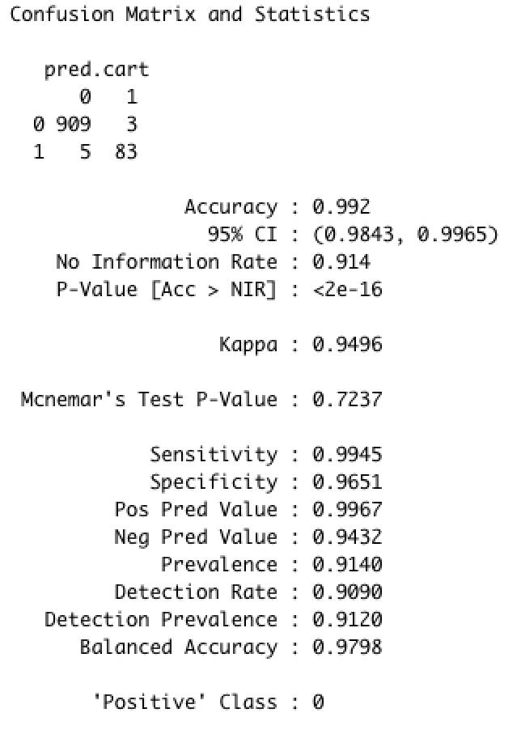
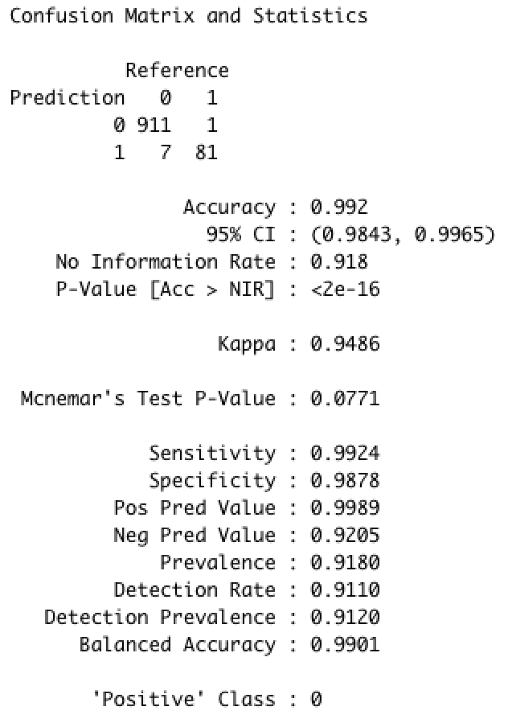
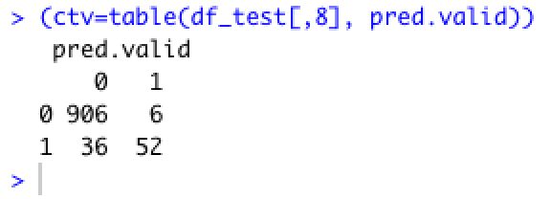
Confusion Matrix – KNN, Random Forest, Logistic Regression
KNN k=3
Random Forest
Logistic
Regression
Confusion Matrix
Notes:
Confusion Matrix visualization.
from sklearn.metrics import confusion_matrix
Compute confusion matrix to evaluate the accuracy of a classification.

Slide 24
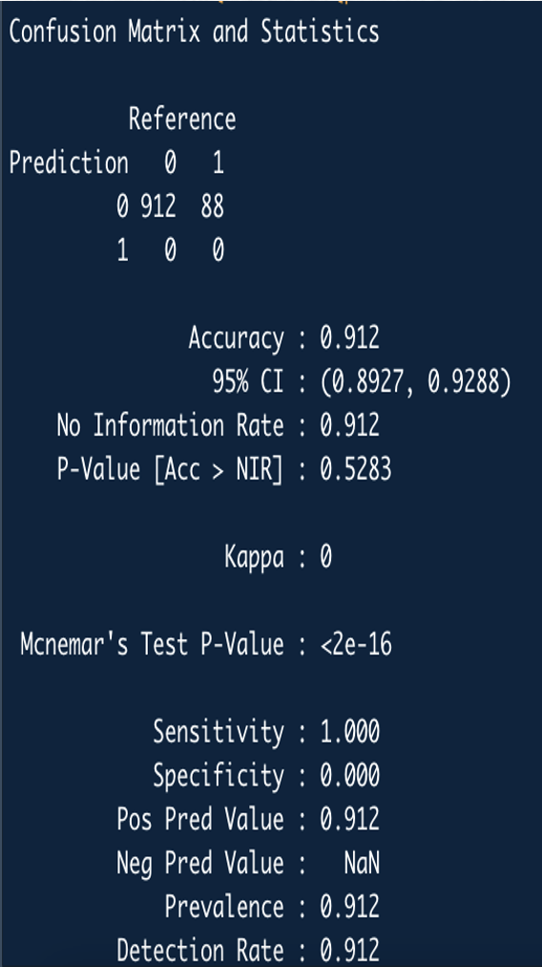
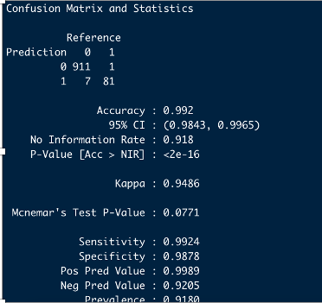
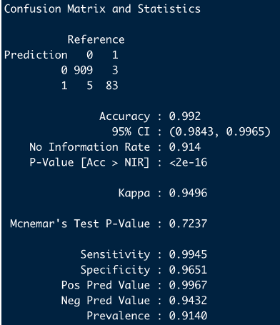
Confusion Matrix – Neural Networks, Ensemble Voting, Ensemble Weighted
Neural Networks
Ensemble - Voting
Ensemble - Weighted
Confusion Matrix
Notes:
Confusion Matrix visualization.
from sklearn.metrics import confusion_matrix
Compute confusion matrix to evaluate the accuracy of a classification.

Slide 25
MODEL COMPARISION
MODEL | ACCURRACY
Logistic Regression | 90.6 %
Random Forest | 99.1 %
KNN ClassifieR | 99.2 %
Neural Networks | 91.2 %
Ensemble | Voting: 99.2 % Weighted: 99.2 %
KNN performed the best with an accuracy of 99.2% followed by Ensemble and random forest with an accuracy of 99.2% and 99.1% respectively.

Slide 26
The fundamental concept behind neural network is a simple but powerful one---- A neural network is a series of algorithms that endeavors to recognize underlying relationships in a set of data through a process that mimics the way the human brain operates. ... Neural networks can adapt to changing input; so the network generates the best possible result without needing to redesign the output criteria.
This discovery has the potential to impact on banking system, becoming a new supporting tool for bankers when predicting if a liable customer responds to banking campaign which inturn leads to bank profits
Finding
.
Notes:
The fundamental concept behind random forest is a simple but powerful one — the wisdom of crowds. In data science speak, the reason that the random forest model works so well is:
A large number of relatively uncorrelated models (trees) operating as a committee will outperform any of the individual constituent models.
The low correlation between models is the key. Just like how investments with low correlations (like stocks and bonds) come together to form a portfolio that is greater than the sum of its parts, uncorrelated models can produce ensemble predictions that are more accurate than any of the individual predictions. The reason for this wonderful effect is that the trees protect each other from their individual errors (as long as they don’t constantly all err in the same direction). While some trees may be wrong, many other trees will be right, so as a group the trees are able to move in the correct direction.

Slide 27
Future Work
Collecting the latest data and implementing the knn model to find the efficiency of the model.
Technically, we would be exploring more models and applying some more methods for better accuracy like accuracy tuning.
We would also like to deploy this model on websites with Visualization tool and would also incorporate user input to directly get the prediction

Slide 28


Slide 29
THANK YOU
Bank Loan Decision Modelling
Narender Reddy Konuganti
Sai Charan Pappala
Gopi Sandeep Guntuku
Sukumar Reddy Kottala

